Slide 1
Preparing for Post Secondary….no matter what grade your child is in!
Kim Spiller
Head of Guidance and Career Education
November 2020

Slide 2
October/November:
Grade 12 students:
Virtual Scholarship/College/University/Apprenticeship/Workplace presentation on October 20 and 21 and is now posted on the Guidance Google classroom and school website- 45 minute detailed presentation.
Emphasis now is on research and virtual school visits, timelines and asking questions this month.
PIN numbers are distributed Oct. 29- University
No PIN required for Colleges
University Applications are due January 15
College Applications are due February 1

Slide 3
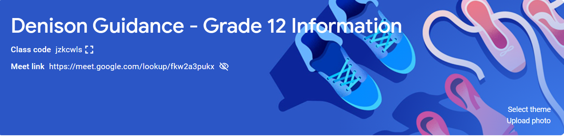
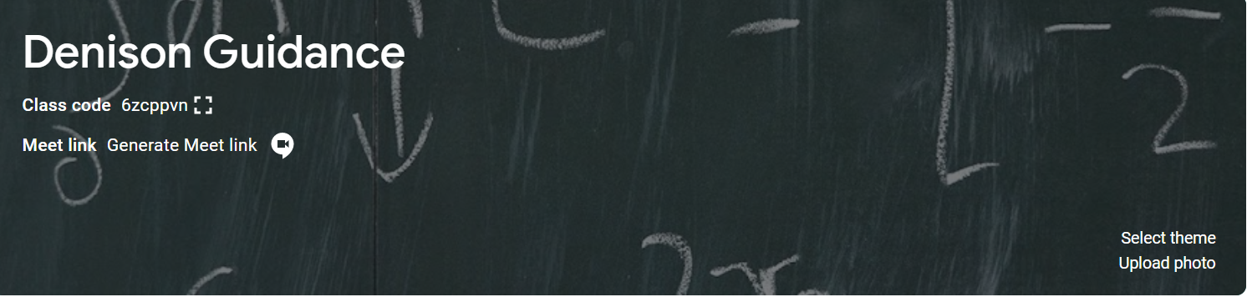
Guidance Google Classroom! https://classroom.google.com/c/MTcwNDY4NDA4MzAx

Slide 4
Research can start in any grade!
www.ontariouniversitiesinfo.ca for university research
www.ontariocolleges.ca for college and trades research
apprenticesearch.com for apprenticeship research
These sites give prerequisites and guidelines on the admission averages as well as the specific courses that students will take in the colleges.
By starting this research early, students can discover what programs exist and what courses they will need to have to apply.
Prerequisites are not always what you think!

Slide 5
Denison School Website - Guidance
Google forms
Important dates
Presentations
Study Skills
Financing Post Secondary
Community Resources
Please note only students have access to the Google Classroom.

Slide 6


Financing Post Secondary:
Grade 12 students have been provided with websites and scholarships are being posted regularly on the Google Classroom.
OSAP can be applied for when the student has an acceptance from a school. Most students apply between April-June.
Please refer to the presentation for details
Grade 9-11 students can/should be preparing by completing volunteer hours, participating in clubs and teams.
Initiating an event or leadership activities are important for acceptances and scholarships!

Slide 7
Connect with Guidance!
Students and parents are encouraged to connect with Guidance virtually by emailing, calling or setting up a google meet.
Kim.Spiller@yrdsb.ca Last name M-Z, ext. 161
Joseph.Zicaro@yrdsb.ca Last name A-L, ext. 162
Students can book a virtual google meet on Appointment Manager on Teach Assist.

